Slide 1
Architecture

Slide 2





Introduction
Swift Version
Subscription Type
Car Model
Software Architect
IOS Car

Slide 3



Application Types
Voice and Messaging
Carmaker
Navigation
Playable Content

Slide 4
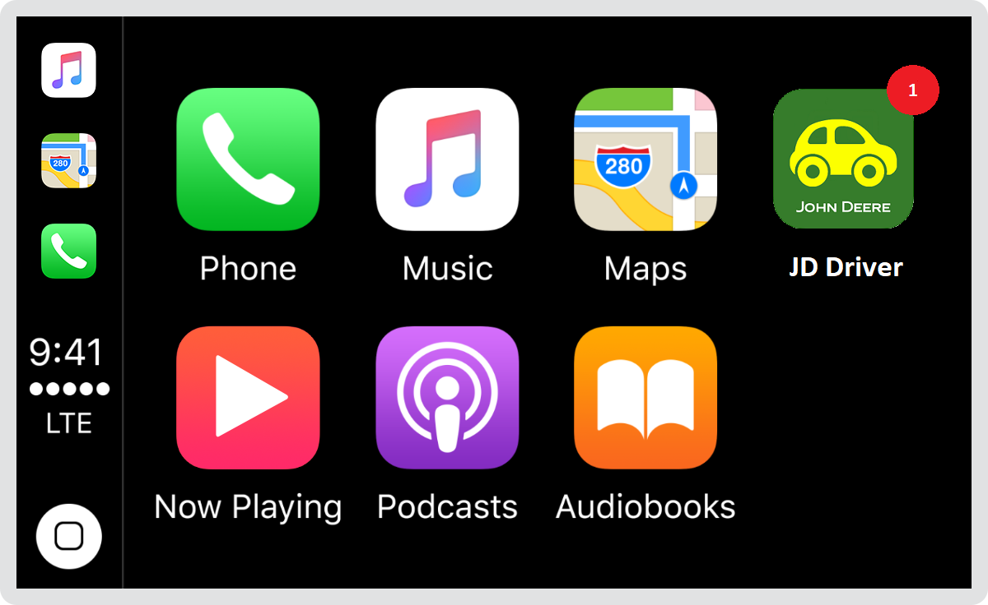
Basic Precautions
1. Badging​
2. Error Handling​
3. Loading​
4. Navigation​
5. Testing

Slide 5
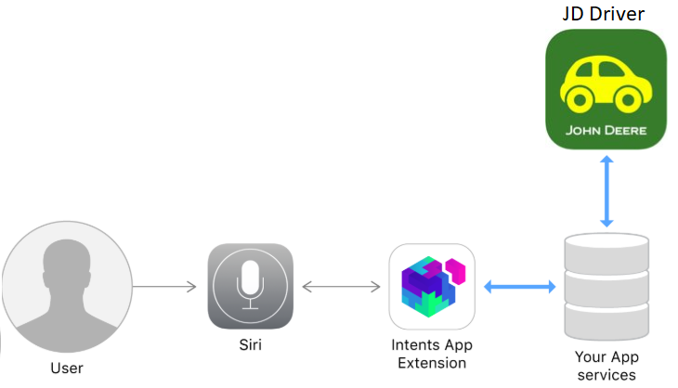
Architecture

Slide 6

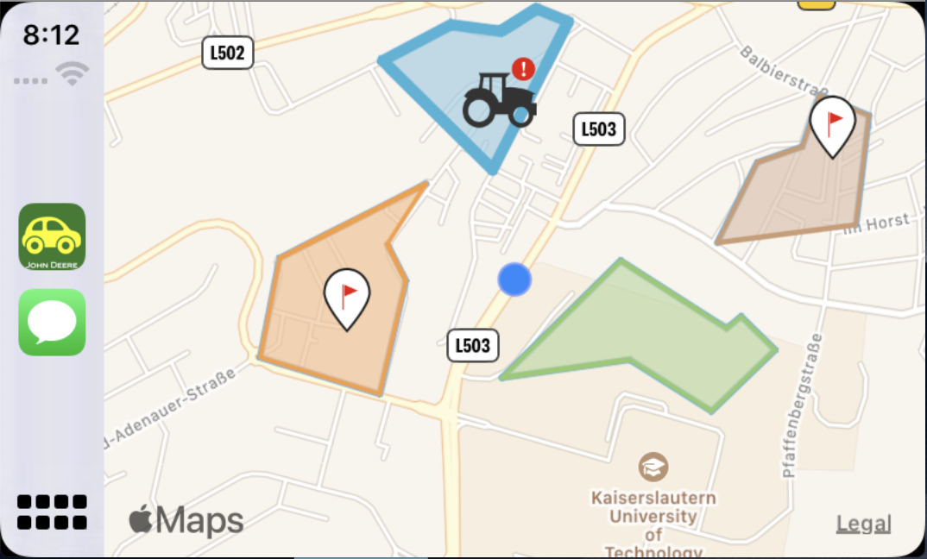

JD Driver
iPhone
Carplay

Slide 7
Architecture Layers - JD Driver
LaunchStoryboard
Storyboard
Xib
Front End
JohnDeere Controller
Scene Delegate
CarPlay Controller
Controllers
AppDelegate
Realm
Alomafire
BCrypt
Back End

Slide 8
Architecture Layers - Siri Intent
IntentsFile
Shortcut Donations
Shortcuts App
Front End
Machine Alert Handler
Fetch Updates Handler
Create Note Handler
Controllers
Machine Alert Target
Fetch Updates Target
Create Note Target
Siri Infrastructure
Targets

Slide 9
Development

Slide 10
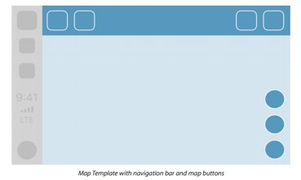

Introduction
Stack
Additional Elements...
MapTemplate
Base View

Slide 11
Base View
XIB File containing only MapKit Object.
Map has to cover whole screen and has to apply appropriate constraints
CarPlayController
Instance of Map from XIB file (reference)
1. Methods for drawing map
2. Methods for drawing overlays
3. Methods for drawing annotations
4. User Location (update)

Slide 12
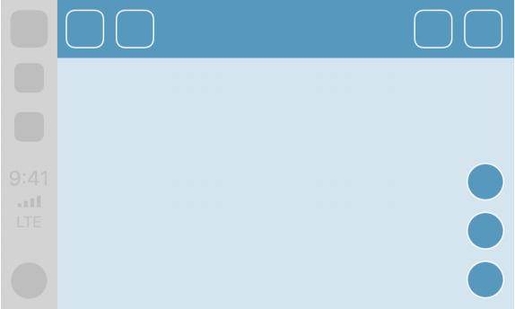
Map Template
Re-Center
Panning

Slide 13
CarPlay Classes
class CPWindow : UIWindow
class CPInterfaceController : NSObject
func setRootTemplate(CPTemplate, animated: Bool)
class CPMapTemplate: CPTemplate
class CPMapButton: NSObject

Slide 14
MapKit Classes
class MKMapView : UIView
protocol MKAnnotation
protocol MKOverlay
class MKOverlayRenderer: NSObject

Slide 15
Realm Classes
class Realm
class Realm.Configuration

Slide 16
Siri Classes
class Intent : INIntent
class IntentResponse : INIntent

